Slide 1
Ship Detection
Zifan Wang
Bowen Jia
Haoxuan Jia
Yicun Hou
Sprint 1
Trello: https://trello.com/b/Oqa6fBy5/ship-detection
Github: https://github.com/Wwwzff/Ship-Detection

Slide 2
Product Statement
As the name presents, Ship Detection is an application based on Yolo v3 to draw out ships from satellite pictures (offered by Airbus Dataset).
It’s designed for organizations like insurance companies and environmental protection agencies to prevent illegal fishing, locate devastating ship accidents and have a closer watch over the open seas.
Our project mainly focus on the optimization of algorithms and better design of UI, in order to bring a better use experience.
Notes:
Provide services for Organizations that need the movement of ships.

Slide 3




Consumers
National government authorities
Environmental Protection Agencies
Insurance Companies
Scientific Organizations

Slide 4

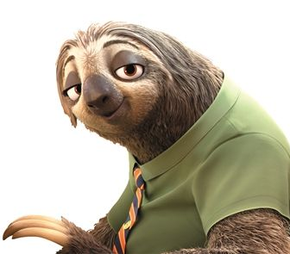
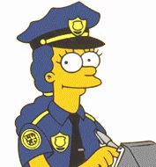

User Stories
As a coast guard, I want to detect illegal fishing, drug trafficking sooner.
As an officer of the Environment Protection Agency, I want to evaluate the influence of shipwreck more efficiently.
As a marine interdiction agent, I want to better investigate the ships around the border.
As an oceanologist, I want to research the ship activities’ influence to the environment.
Notes:
Here’s our user stories, we would like to provide fast access to the location of ships for officers and help scientists get the ship movement data easier.

Slide 5
Minimum Viable Product (MVP)
Algorithm can work well and draw location of ships within a relatively small deviation.
Be robust to some kind of noises from satellite pics like reef, seashore and houses.
UI logics should be easy to handle with for consumers.
If time allows, we will improve the algorithm’s speed and do some fine tunings to the whole software
Notes:
So the above three points are the most important things that we will be doing.

Slide 6


Background
Frameworks
- Yolo v3
languages
- Python
- C#/JAVA
Challenges
- Blurs (shadow, cloud), Similar Objects (reef, houses)
- Calculate fast in order to deal with tremendous dataset (100,000+ pics)
- Detection Accuracy
Notes:
Now I will be introducing the background research we did on our project. The framework we are planning to us is yolo v3 and it’s programed with python, also we will be using c# or JAVA to develop our application. The main challenges we will be facing is the blurs which can effect our detecting and the large amount of images our users may input. We will need to deal with these problems to get a better outcome.

Slide 7
Background: obj. detection
Detects certain objects in an image and label out the position of it.
There are two approaches to do this:
Single stage method
examples: YOLO, SSD(Single Shot Detector)
Two stage method
examples: RCNN, Fast RCNN, Faster RCNN
Notes:
We will be using object detection with deep learning in our project and object detection can find out what is in an image and where it is. There are mainly two approaches to do this: one is the single stage method such as Yolo and ssd, the other one is two stage method , examples are RCNN and fast rcnn,

Slide 8
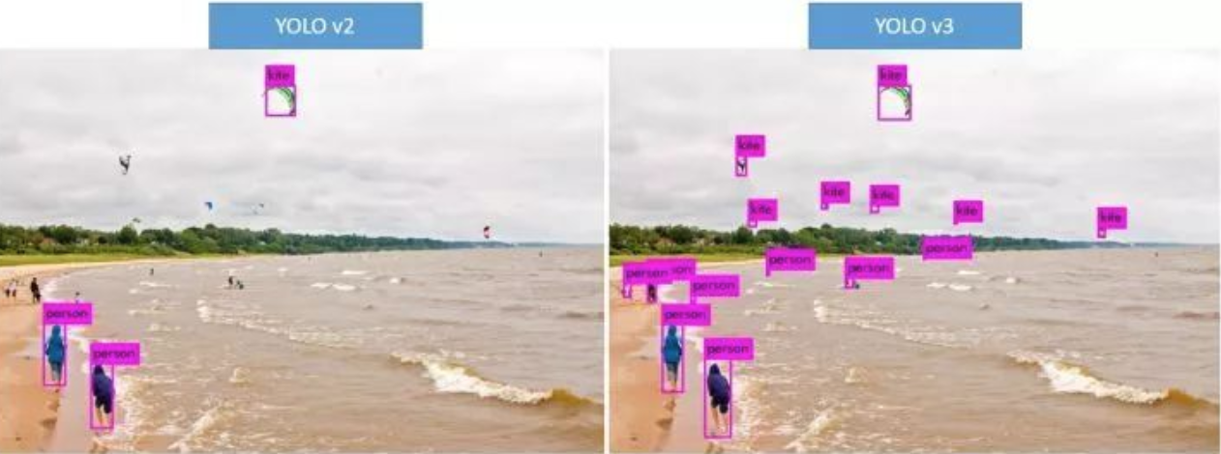
Why Yolo V3
Yolo V1
Fast but the resolution of input images must be the same with train set and results are bad when detecting small images
Yolo V2
Improved the position accuracy and is able to adjust to the size of input images
Yolo V3
Better in accuracy than SSD, but 3 times faster
Able to detect multiple labels in one object
More flexible to the resolution of images
Notes:
So why do we use Yolo v3, first of all, it's fast compared to other object detection methods, also evolving from version one to version three, many great features has been add and the accuracy of yolo v3 is as good or even better than other models. In addition to that yolo v3 improved the performance of detection when it comes to small objects, which is suitable for our project.

Slide 9

System Diagram
*
Initialize parameters for the learning framework
Input a picture
Apply pre-processing steps
to remove noises
(will be remove if it doesn’t work)
Input a picture from training set
Use learning model to predict the location of the ship
Output the trained model
Process on the picture
Renew
Parameters
Fine-tuning on the picture
e.g. draw the contours of ships for better users’ interface
Figure out deviation
No
Below threshold?
Yes
Output the result
Notes:
Here is the diagram of our system, it has two parts, on the left is our deep learning process and on the right is the appcation we will build. we use the dataset from Kaggle to train the model and by tuning the parameters we can a model that is the most suitable for our project. Then we will use this model in our application to deal with the images, we might need to do some preprocessing depending on the outcome of the model. If time permits we will also do some fine-tuning on the images, such as drawing out the contours of the ships.

Slide 10
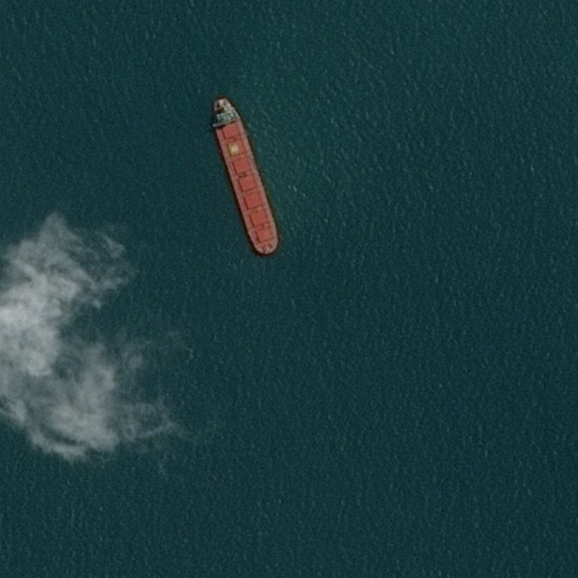
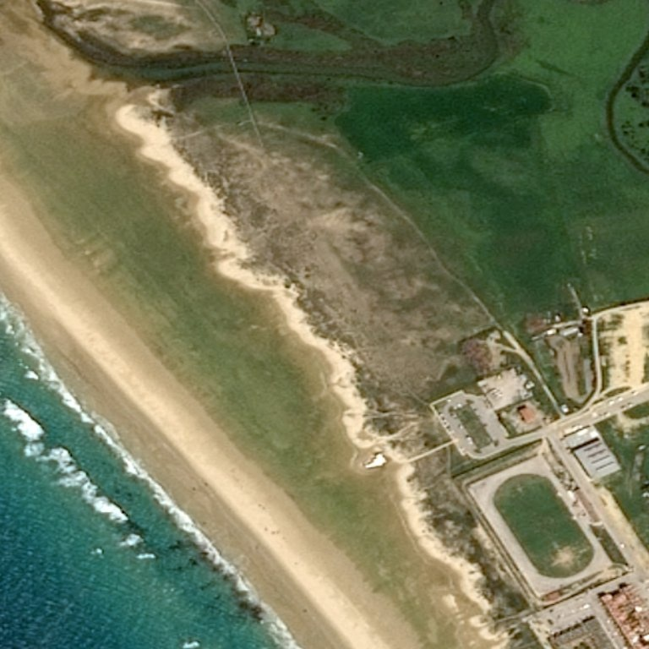
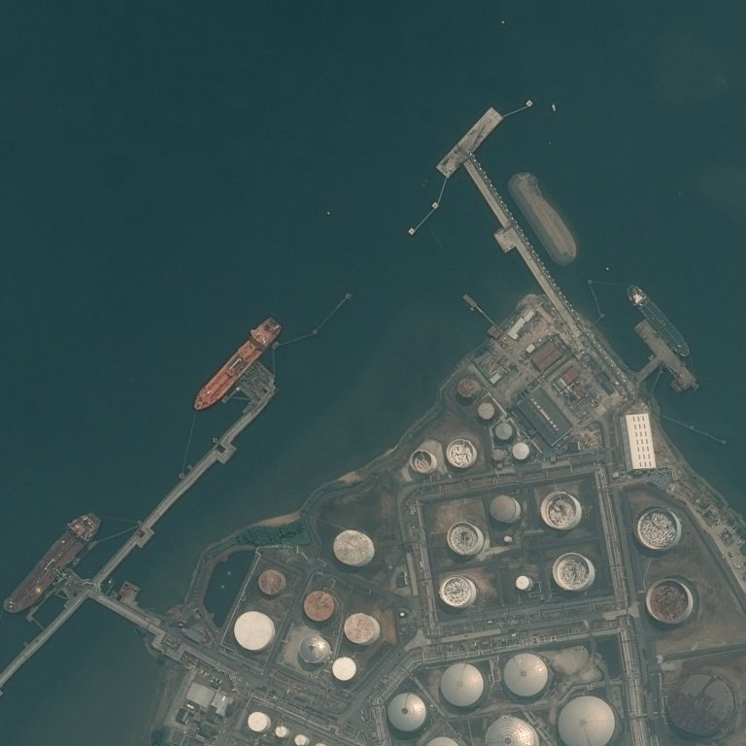
App Outline
*
Training & Annotation
Output
Pre-treatment
Image sharpening
Noise reduction
Yolov3 algorithm (or others if works better)
Save result pics
Count processing time
‹#›

Slide 11
Division of Tasks
*
Zifan Wang
Application development, Algorithm adjustment
Haoxuan Jia
Parameter tuning, Algorithm adjustment
Bowen Jia
Structure building,Algorithm adjustment
Yicun Hou
UI design, Algorithm adjustment
Notes:
We divided our tasks into five parts, such as application development and parameter tuning, and since we will be mainly focusing on the performance of the algorithm, all of us will all work on the algorithm adjustment part.

Slide 12
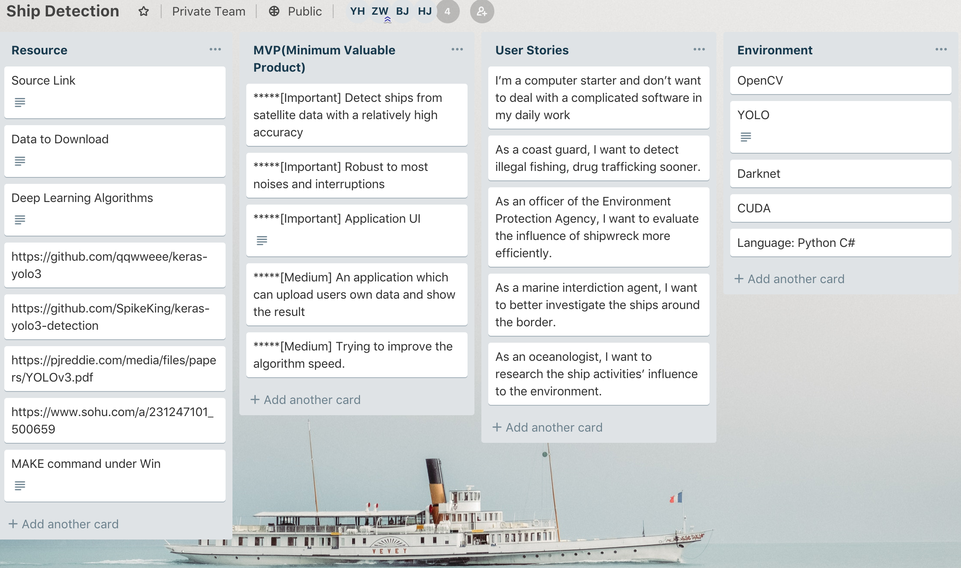
Trello
*

Slide 13
Reference
https://pjreddie.com/darknet/yolo/
https://github.com/qqwweee/keras-yolo3
https://github.com/SpikeKing/keras-yolo3-detection
https://towardsdatascience.com/yolo-v3-object-detection-53fb7d3bfe6b
http://cs231n.github.io/convolutional-networks/
https://en.wikipedia.org/wiki/Convolutional_neural_network
https://towardsdatascience.com/evolution-of-object-detection-and-localization-algorithms-e241021d8bad
https://www.jeremyjordan.me/object-detection-one-stage/

Slide 14
Thank You !
Zifan Wang chesterw@bu.edu
Bowen Jia jeff0410@bu.edu
Haoxuan Jia hxjia@bu.edu
Yicun Hou yicunhou@bu.edu

